Slide 1
Bigger Isn’t Better The ethical and scientific vices of extra-large datasets in language models
Trystan S. Goetze (he/they/she)
Darren Abramson (he/him)
Dalhousie University
PhiloWeb ‘21 / ACM WebSci ‘21
Slide deck available at: bit.ly/philoweb21

Slide 2
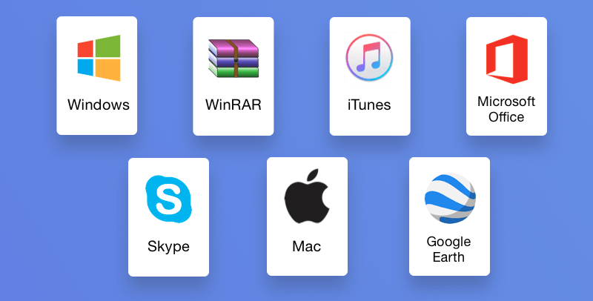
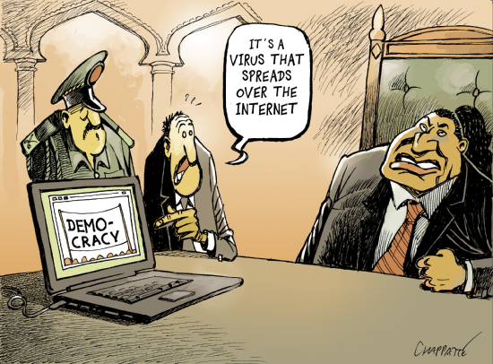
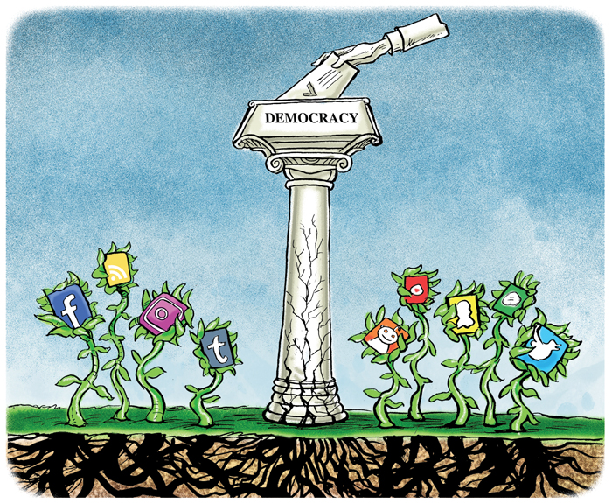
The dialectic
One way to describe the history of computing is as a series of pendulum swings between two extremes.
Techno-utopianism: A dream of a post-scarcity society enabled by widespread adoption of computing innovations. (Cf. Stallman 1993)
Techno-capitalism: A world where centralized, corporate control of computing technologies generates profit and useful services from every data point and innovation produced by end users. (Cf. Suarez-Villa 2009)

Slide 3
Where the pendulum rests…
In this paper, we’re concerned with a swing towards the techno-capitalist side in the field of language models (LMs).
LMs have become much more accessible outside of a research context in recent years, thanks to projects like Watson and OpenAI.
Part of the recent success of LMs is because of their size: datasets and models are growing larger and larger.
Large LMs and large datasets are possible in part because large corporations (e.g., IBM, Microsoft, Amazon) sell cloud computing and human intelligence services.

Slide 4
Further dangers of stochastic parrots
Some of the ethical problems with this ‘bigger is better’ approach to LM development were raised by Bender et al. (2021):
Rising environmental impact of computer processing
Rising financial cost of hiring compute time
Increased difficulty of determining what is in datasets (especially regarding bias)
We want to go further than Bender et al. to suggest:
Some additional ethical problems with extra-large LMs & datasets
How ethical and scientific problems in LM development are tied together

Slide 5
The Plan
The Human Cost of Human Intelligence
Know Your Data
Epistemological Implications
Exploring Datasets
Conclusion

Slide 6
Crowdwork and datasets
Hire crowdworkers to complete brief tasks that require human intelligence, like answering surveys or annotating images. Often paid only a few cents a task.
Crowdworkers turn out to be a useful way to create very large language datasets for challenging LMs.
Example: CommonsenseQA (Talmor et al. 2019) attempts to test an LM’s grasp of commonsense relations between concepts through questions like:
Where would you not want a fox? (A) hen house (B) england (C) mountains (D) forest
The questions are based on conceptual associations in a dataset called ConceptNet (Speer et al. 2018), and are generated and validated by different groups of crowdworkers.

Slide 7
Abuses in the microtask economy
Low pay (typically below minimum wage)
Large amount of unpaid ‘downtime’ (searching for tasks, vetting work requesters, refreshing the page, dealing with connection problems)
Crowdworkers are ineligible for benefits and labour protections
Subject to deceit and intimidation from the platform managers
These issues have been widely discussed, but crowdworkers continue to be engaged for the creation of datasets
It is unclear how widespread remedies, such as the Fair Work scheme (Whiting et al. 2019), have been implemented

Slide 8
Crowdwork and quality
One familiar worry: dataset bias
Paolacci and Chandler (2014), writing about the use of crowdworker surveys in social science, note that workers may be diverse but are often not representative of the groups to which they belong, distorting the sample.
Bender et al. (2021) note that many datasets fail to track demographic markers of crowdworkers at all, making it hard to detect linguistic bias. They suggest adding data statements (Bender & Friedman 2018) with demographic information on data creators and annotators.
In addition, we suggest that the exploitative nature of the crowdwork economy may contribute to low-quality datasets.
Creating linguistic challenges requires close attention to subtle details
Given the pressures of the crowdwork economy, we can assume that many crowdworkers won’t have the time or attention.

Slide 9
Increased Financial Costs
In many cases, researchers may be cutting costs at the dataset creation stage (through crowdwork) in order to spend more on computing resources for training and testing LMs.
Bender et al. worry that the increased financial cost will be prohibitive to many researchers.
Less resourced academics and smaller private developers may be priced out, compounding the ‘diversity crisis’ in AI research (West et al. 2019).
This will contribute to ongoing problems with bias in AI generally, and slow LM research progress.

Slide 10
Corporate interests and research
Corporate interests may start to drive the research, rather than simply providing the services that enable the research.
Kuhn & Stallman (2001): Proprietary software can reduce the autonomy of end users and small developers.
In other situations where researchers are dependent on large corporations, corporate interference has damaged the science.
Example: Brown (2002) notes that in pharmaceutical research, industry-sponsored work tends to favour the sponsors’ products, and in some cases, the sponsors have tried to prevent damaging findings from being published.
In light of Gebru and Mitchell being ousted from Google over the Bender et al. paper (among other things), we should be wary of similar conflicts of interest and interference from cloud computing companies.
Corporate interests might push for bigger and bigger datasets and LMs despite the harms involved in their creation, and even if we see diminishing returns on larger datasets and LMs.

Slide 11
Exploring datasets
Another problem noted by Bender et al. is that the contents of large datasets are difficult to scrutinize, and impossible to curate.
Given the worries about dataset quality mentioned earlier, it is especially important for peer reviewers and other researchers to be able to check the contents of datasets for themselves.
To this end, we introduce a new class of tool: the NLP_Explorer (Abramson 2021)
These tools are executable python files run from the command line.
They pull from datasets such as CommonsenseQA and present a selection of items as a multiple choice quiz for the user.
We suggest that in addition to data statements, large datasets should come with an NLP_Explorer

Slide 12
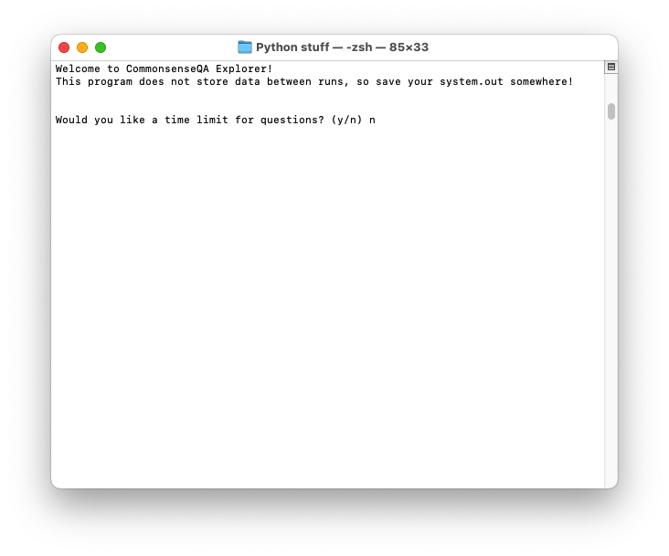

Slide 13
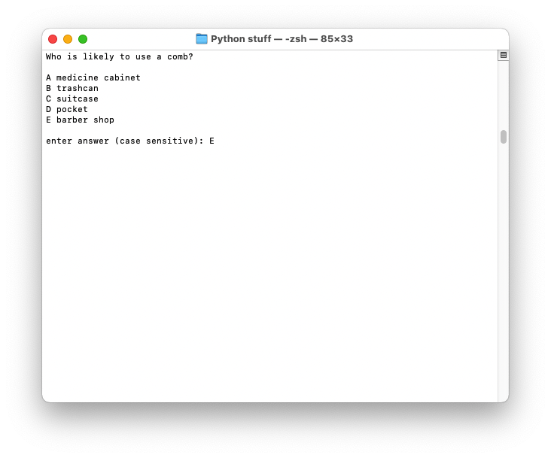

Slide 14
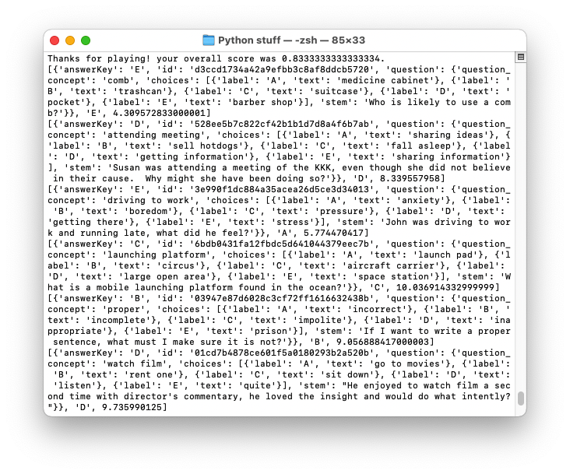

Slide 15
Prompt | Answers | Issue
She couldn’t hide that she liked the boy she was talking to, she had a constant what? | (A) Make eye contact (B) Smile (C) Another person (D) Listening (E) Compliment | Only the solution agrees with the sentence
Where might be an odd place to put a washing machine? | Laundromat Wash clothes Cellar House Garage | Questionable solution
What is a steel cable called a winch primarily used for? | (A) Factory (B) Building (C) Winch (D) Ship (E) Tightrope | Multiple potentially correct answers (C and D)
A selection of problematic prompts discovered in CommonsenseQA using CQA_Explorer.

Slide 16
Conclusion
Combining our contributions with Bender et al., here are the ethical worries about large datasets in LM research:
Environmental impact
Financial cost reduces research community diversity
Large datasets require cheap, harmful labour to create
Large datasets require corporate-controlled computing resources
These produce epistemological problems:
Reduced diversity => more bias
Cheap labour (i.e., crowdwork) is not conducive to quality linguistic challenges
Large datasets are difficult to scrutinize for bias and other quality issues
Corporate interests may start to drive LM research

Slide 17
Take-home messages
Researchers should consider whether a large dataset or model is actually needed to meet their goals
Research ethics boards and other forms of institutional oversight should become familiar with the ethical and scientific problems of using crowdwork
Datasets should come with data statements and explorers so others can evaluate their quality
Alternatives to corporate controlled computing resources should be made more available

Slide 18
Thanks!
Works Cited
Abramson, Darren. 2021. nlp-data-explorer. GitHub repository. https://github.com/DarrenAbramson/nlp-data-explorer
Bender, Emily, and Batya Friedman. 2018. Data Statements for Natural Language Processing: Toward Mitigating System Bias and Enabling Better Science. Transactions of the Association for Computational Linguistics 6, 587–604.
Bender, Emily, Timnit Gebru, Angelina McMillan-Major, and Shmargaret Shmitchell. 2021. On the dangers of stochastic parrots: Can language models be too big? 🦜. In Proceedings of the 2021 ACM Conference on Fairness, Accountability, and Transparency, 610–23. https://doi.org/10.1145/3442188.3445922
Brown, James. 2002. Funding, Objectivity and the Socialization of Medical Research. Science and Engineering Ethics 8(3), 295–308.
Kuhn, Bradley, and Richard Stallman. 2001/2015. Freedom or Power? In Free Software, Free Society: Selected Essays of Richard M. Stallman (3rd ed.). Boston: Free Software Foundation. 257–8.
Paolacci, Gabriele, and Jesse Chandler. 2014. Inside the Turk: Understanding Mechanical Turk as a Participant Pool. Current Directions in Psychological Science 23, 3 (2014), 184–188. https://doi.org/10.1177/0963721414531598
Speer, Robyn, Joshua Chin, and Catherine Havasi. 2018. ConceptNet 5.5: An Open Multilingual Graph of General Knowledge. arXiv:1612.03975 [cs.CL]
Stallman, Richard. 1993. The GNU Manifesto. https://www.gnu.org/gnu/manifesto.html
Suarez-Villa, Luis. 2009. Technocapitalism : A Critical Perspective on Technological Innovation and Corporatism. Philadelphia: Temple University Press.
Sarah Myers West, Meredith Whittaker, and Kate Crawford. 2019. Discriminating Systems: Gender, Race, and Power in AI. Technical Report. AI Now Institute. https://ainowinstitute.org/discriminatingsystems.pdf
Talmor, Alon, Jonathan Herzig, Nicholas Lourie, and Jonathan Berant. 2019. Com- monsenseQA: A Question Answering Challenge Targeting Commonsense Knowledge. arXiv:1811.00937 [cs.CL]
Whiting, Mark, Grant Hugh, and Michael Bernstein. 2019. Fair Work: Crowd Work Minimum Wage with One Line of Code. Proceedings of the Seventh AAAI Conference on Human Computation and Crowdsourcing, 197–206.
You can reach us in the following ways:
Trystan Goetze
Email: contact@trystangoetze.ca
PhilPeople: https://philpeople.org/profiles/trystan-s-goetze/
LinkedIn: https://www.linkedin.com/in/trystan-goetze/
Twitter: @errantcanadian
Web: https://www.trystangoetze.ca/
Darren Abramson
Email: da@dal.ca
Twitter: @DarrenAbramson
Web: http://www.darrenabramson.com/

