Slide 1
Hermeneutical Justice for Extremists?
Trystan S. Goetze (he/they/she), Dalhousie University
Charlie Crerar (he/him), University of Connecticut
CPA 2020 2021
Slide deck available at: bit.ly/cpa-hi
Content Warnings:
Discussion of violence and hate motivated by Islamophobia. Mention of sexual assault, sexual harassment.

Slide 2
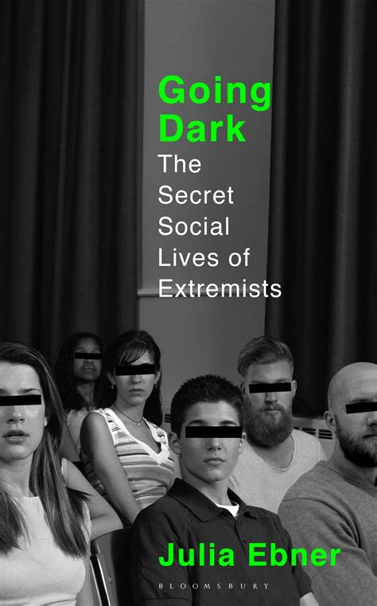
The Conundrum
Extremist rhetoric and extremist social views often seem not to make sense to us when we hear them.
In some instances, we are puzzled as to what the extremist’s view even means, or if it is anything more than unintelligible nonsense.
“I have never found it more difficult to pretend to belong to a group of people than in the festival grounds of Ostritz. Meeting neo-Nazis in real life did not bring me any closer to their reality… I find it hard to connect with them on a human level, to look past their ignorance towards their own history or to have even the slightest understanding of their ways of perceiving the world.” (Ebner 2020, 205, 207)
Our problem: If we stipulate that the extremists are marginalized, it looks a lot like they suffer a type of epistemic injustice.
Do such extremists deserve epistemic justice? Does that entail tolerating or even accepting their views?

Slide 3
The Plan
Hermeneutical Injustice
Marginalized Extremists
Justice for Extremists?
The Demands of Hermeneutical Justice
Hermeneutical Marginalization as a Catalyst for Extremism

Slide 4
Hermeneutical Injustice (Fricker 2007)
Hermeneutical Marginalization: When a group has been unfairly excluded from social processes by which society generates and shares hermeneutical resources on a wide scale.
Hermeneutical Injustice (HI): When a group’s hermeneutical marginalization creates a gap in shared hermeneutical resources that causes a breakdown in understanding of the subject’s distinctive and important social experiences.
Standard example: the term (and concept of) sexual harassment.

Slide 5
Cognitive vs. Communicative (Goetze 2018)
Cognitive HI: When the subject’s own understanding is rendered unintelligible (to themselves).
Hermeneutical Impasses: A gap in shared hermeneutical resources causes a breakdown in communication (Anderson 2017).
Communicative HI:
The subject’s attempt to communicate about one of their distinctive social experiences ends in a hermeneutical impasse.
The gap in shared hermeneutical resources that produces the hermeneutical impasse is an effect of the subject’s hermeneutical marginalization.

Slide 6
Marginalized Extremists?
Example (from Romdenh-Romluc 2016): The English Defence League (EDL).
An islamophobic protest organization prominent in the UK in the 2010s.
Romdenh-Romluc argues that the EDL meets the criteria for communicative HI.
On the one hand, their attempts to present their group as a human rights organization don’t gel with the mainstream understanding of what a human rights organization is like.
On the other hand, the EDL is largely composed of working-class and impoverished people who have been denied educational opportunities.
The working class is a hermeneutically marginalized group in the UK.
So, Romdenh-Romluc argues, the EDL look like they can argue that:
The mainstream of society hits a hermeneutical impasse when encountering their claims about being a human rights organization.
The impasse results because of their hermeneutical marginalization qua working-class English people.
Ergo, the EDL are subject to communicative HI.

Slide 7
Justice for Extremists?
Just how troubling is this result?
This depends on what we owe to subjects of HI.
Fricker (2007) writes that in response to HI, we should cultivate an ethical-epistemic virtue she calls hermeneutical justice (HJ).
This virtue minimally requires granting the benefit of the doubt to the subject regarding the intelligibility of their assertions.
But HJ may also require going further to engage with the subject to create shared understandings.

Slide 8
What does HJ require?
Fricker (2007): Remedy for dismissals of “women’s intuition” is greater acceptance of stereotypically feminine manners of expression.
Jenkins (2017): Remedy for sexual assault myths is their replacement by better conceptions of these crimes developed by feminists.
HJ appears to require accepting the marginalized subject’s social interpretations, with the goal of widespread acceptance.
Problem 1: Engaging with extremists can be dangerous.
Problem 2: Being required to accept extremist views is absurd.
Romdenh-Romluc treats this as a reductio of HI.

Slide 9
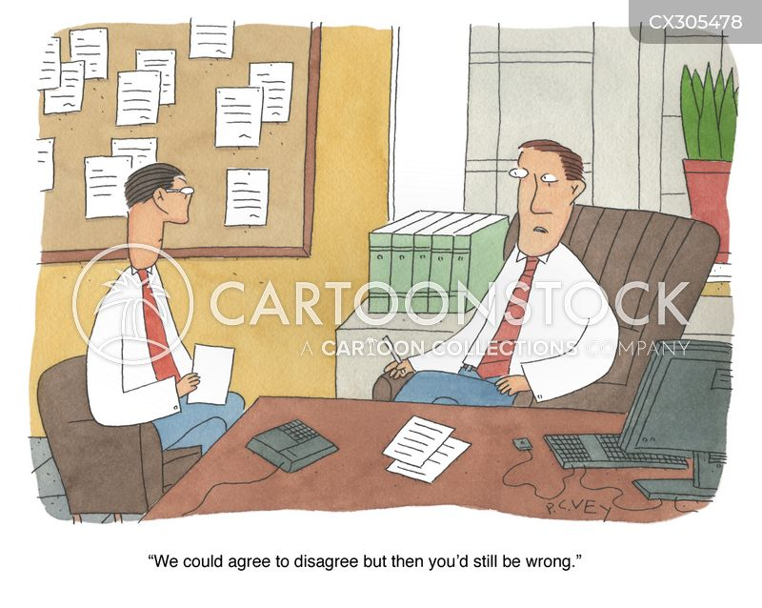
Reconsidering HJ
The virtue of HJ is a palliative, not a cure, given the structural nature of the injustice (Langton 2010).
We should, in addition to cultivating this virtue, work to eliminate the conditions for HI.
Conceived this way, HJ is a state to be achieved by eliminating those conditions.
One approach: eliminate the hermeneutical impasse.
Note that this only requires understanding what the marginalized speaker is trying to convey. We can still disagree on which interpretation is apt.
So, HJ does not require that we accept or tolerate the views of extremists.
Cf. Pilkington (2016, 24) conducted an ethnographic study of the EDL, wherein she stressed to her interviewees that her “aim was ‘to understand’ rather than represent the movement in a positive or negative light.”

Slide 10
Marginalization and Radicalization
Recall the notion of cognitive HI, where the subject’s own social understanding is impoverished by a hermeneutical gap.
If groups like working-class English people are hermeneutically marginalized, this offers a potential explanation of the turn to extremism some of them take.
Suppose: in the absence of apt hermeneutical resources to conceptualize their marginalized status, they turn to (or invent) extremist, anti-immigrant, Islamophobic hermeneutical resources.
This could be among the pathways to radicalization (cf. Cassam 2018).
An epistemically just society may well be less conducive to extremism.

Slide 11
Thanks!
Works Cited
Anderson, L. (2017). Hermeneutical Impasses. Philosophical Topics 45(2): 1–19.
Cassam, Q. (2018). The Epistemology of Terrorism and Radicalization. Royal Institute of Philosophy Supplement 84: 187–209.
Ebner, J. (2020). Going Dark: The Secret Social Lives of Extremists. London: Bloomsbury.
Fricker, M. (2007). Epistemic Injustice: Power and the Ethics of Knowing. Oxford: Oxford University Press.
Goetze, T.S. (2018). Hermeneutical Dissent and the Species of Hermeneutical Injustice. Hypatia 33(1): 73–90.
Jenkins, K. (2017). Rape Myths and Domestic Abuse Myths as Hermeneutical Injustices. Journal of Applied Philosophy 34(2): 191–205.
Langton, R. (2010). REVIEW: Epistemic Injustice: Power and the Ethics of Knowing. Hypatia 25: 459–64.
Pilkington, H. (2016). Loud and Proud: Power and Politics in the English Defence League. Manchester: Manchester University Press.
Romdenh-Romluc, K. (2016). Hermeneutical Injustice: Blood-Sports and the English Defence League. Social Epistemology 30(5–6): 592–610).
You can reach me in the following ways:
Email: contact@trystangoetze.ca
PhilPeople: https://philpeople.org/profiles/trystan-s-goetze/
LinkedIn: https://www.linkedin.com/in/trystan-goetze/
Twitter: https://twitter.com/errantcanadian/
Web: https://www.trystangoetze.ca/

