Slide 1
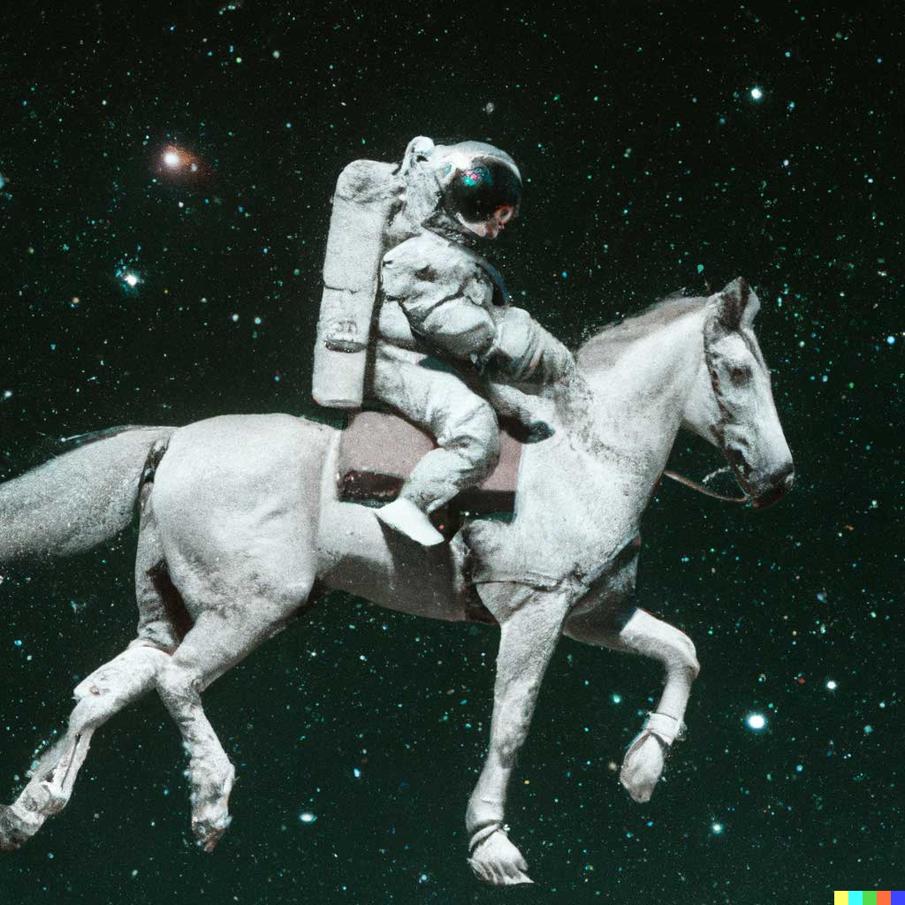
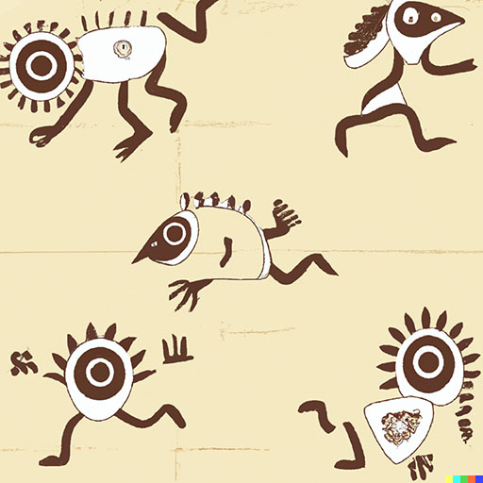
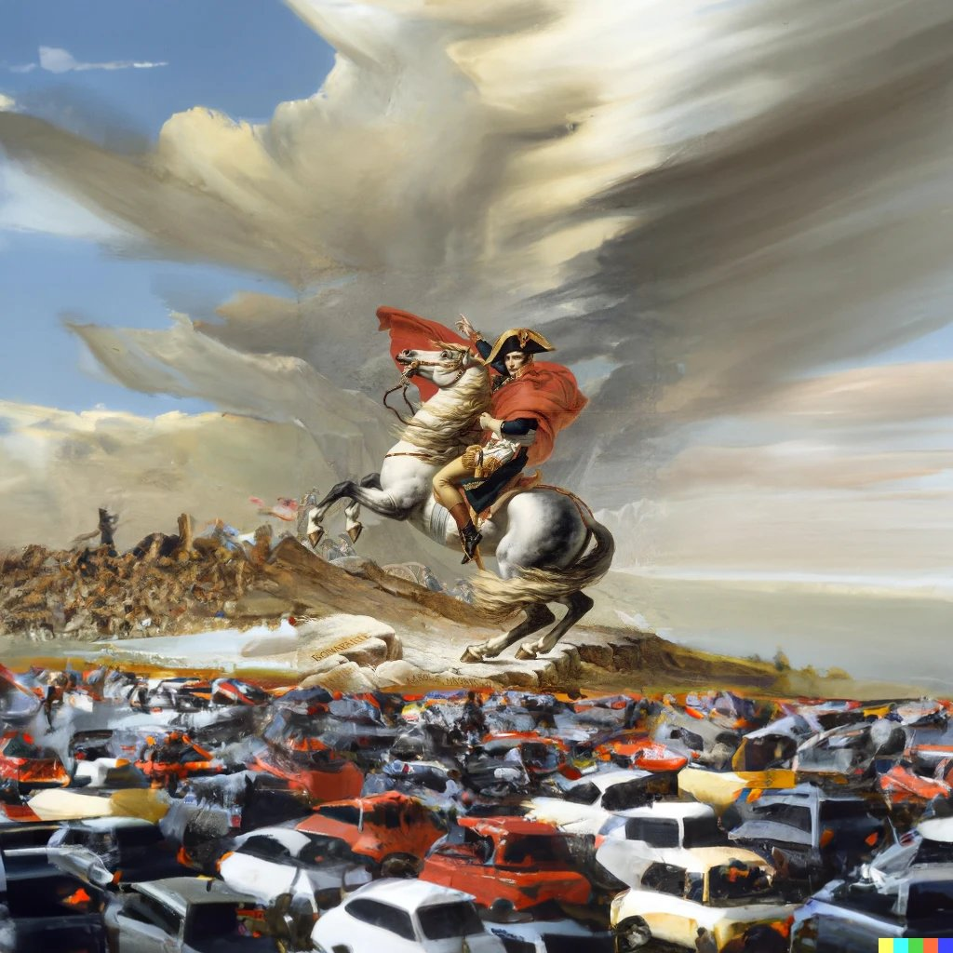
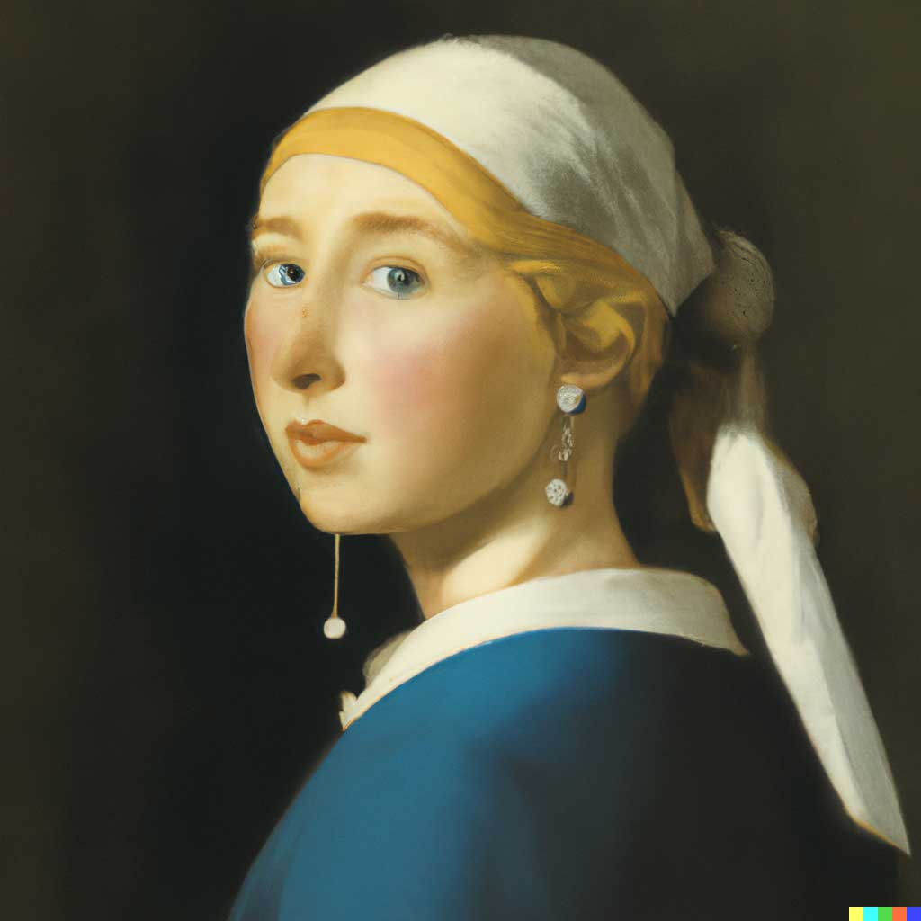
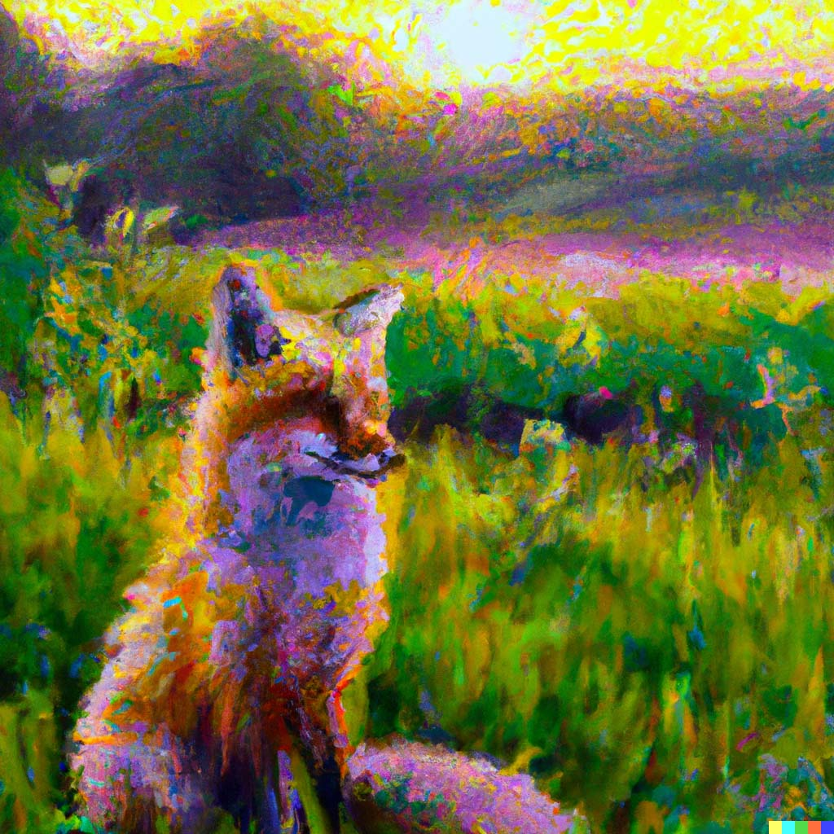
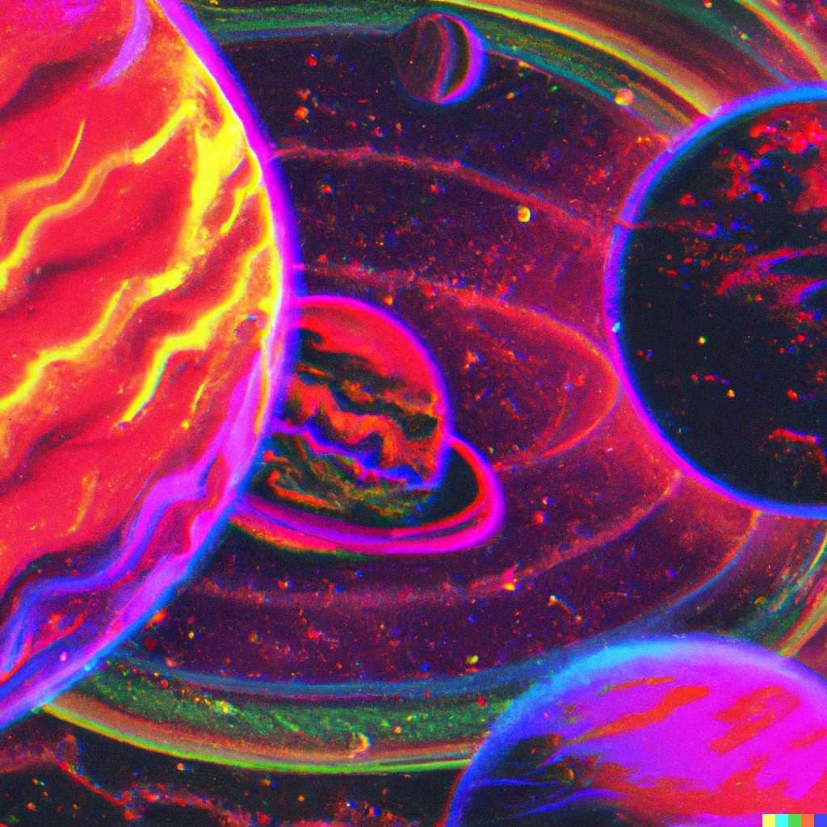
Is AI Art Theft?
Trystan S. Goetze
Harvard University

Slide 2
Handout & Presentation Downloads
bit.ly/CalPolyTG

Slide 3
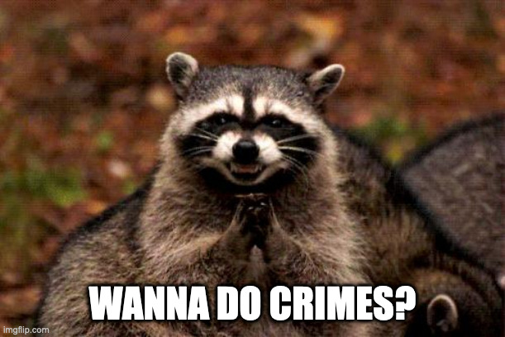

Slide 4
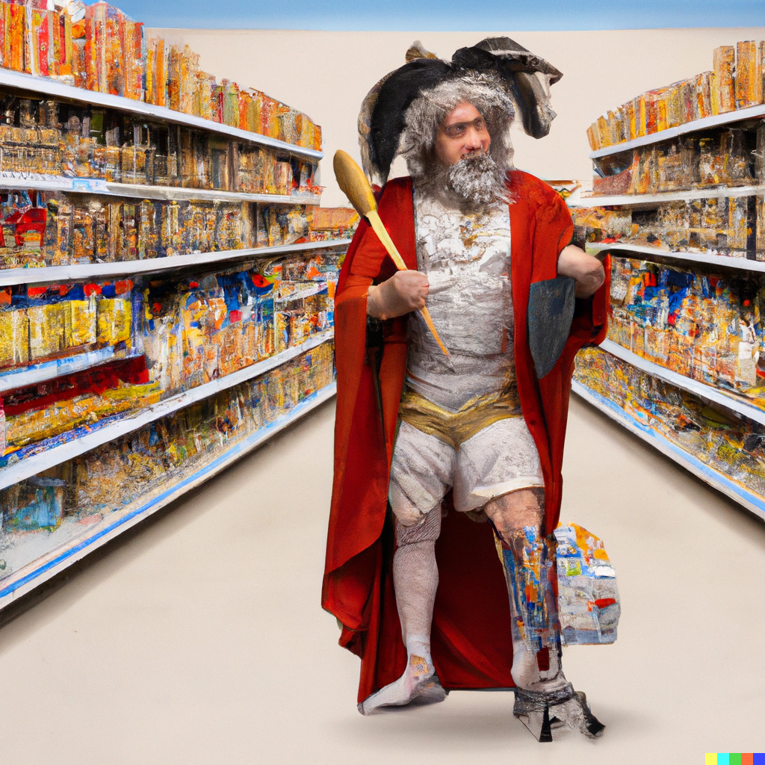
Here’s one I did earlier…
“Aristotle wearing a clown wig in the Tesco grocery aisle sharpening a spoon, renaissance painting”

Slide 5
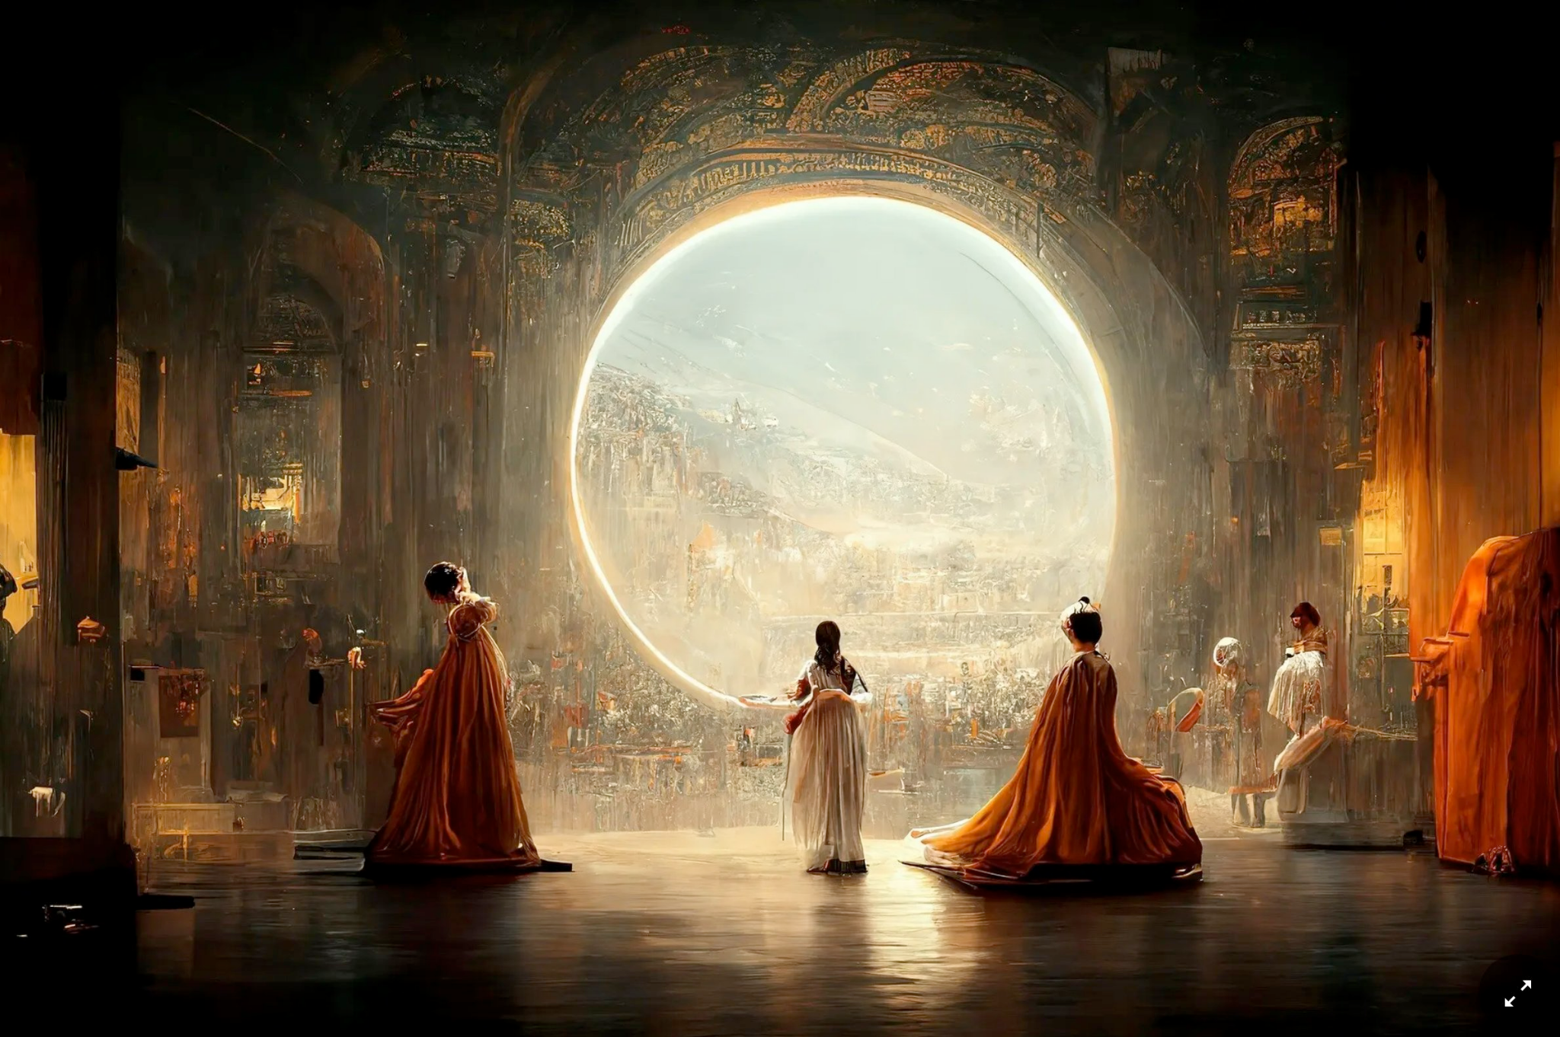

Slide 6
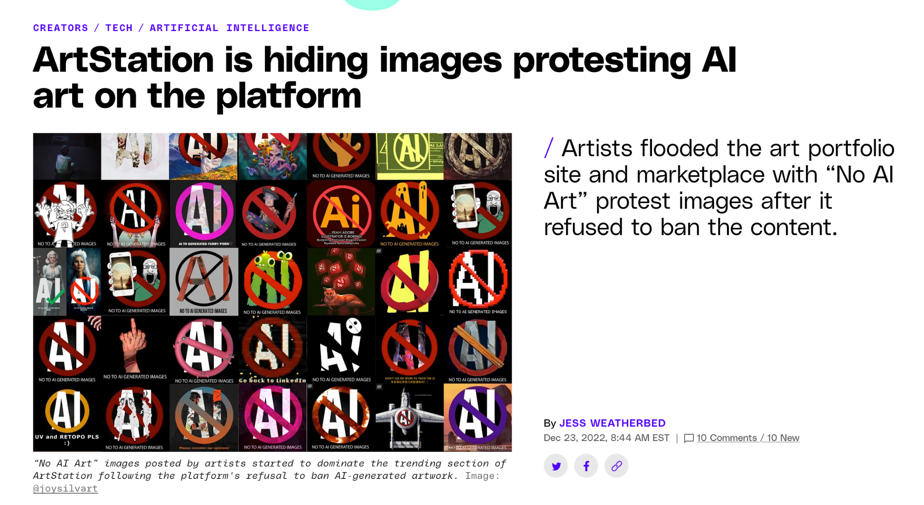
Notes:
https://www.theverge.com/2022/12/23/23523864/artstation-removing-anti-ai-protest-artwork-censorship

Slide 7
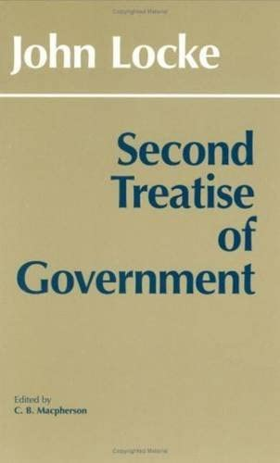
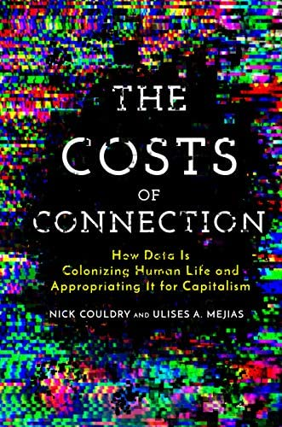
The Plan
1. What is theft? 2. AI image generation 3. Labour theft 4. Plunder 5. Implications & recommendations

Slide 8
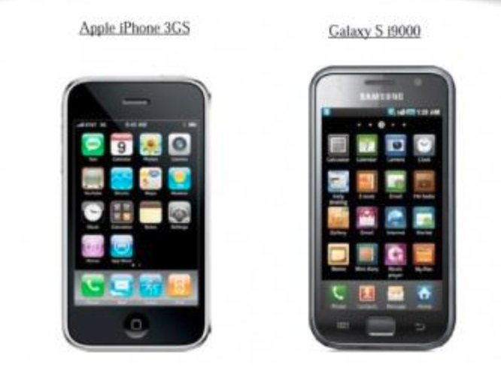
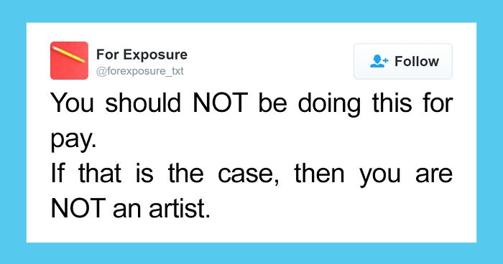
What is Art Theft?
Heist
Plagiarism
Style Theft
Labour Theft

Slide 9
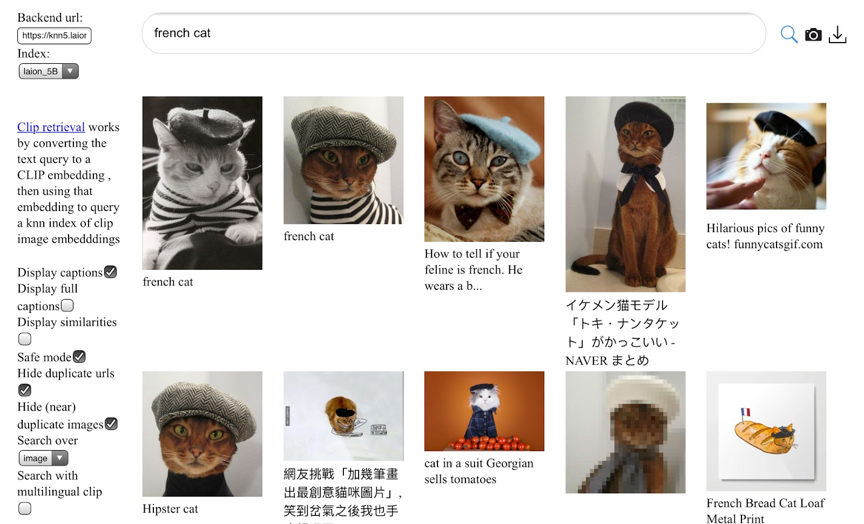
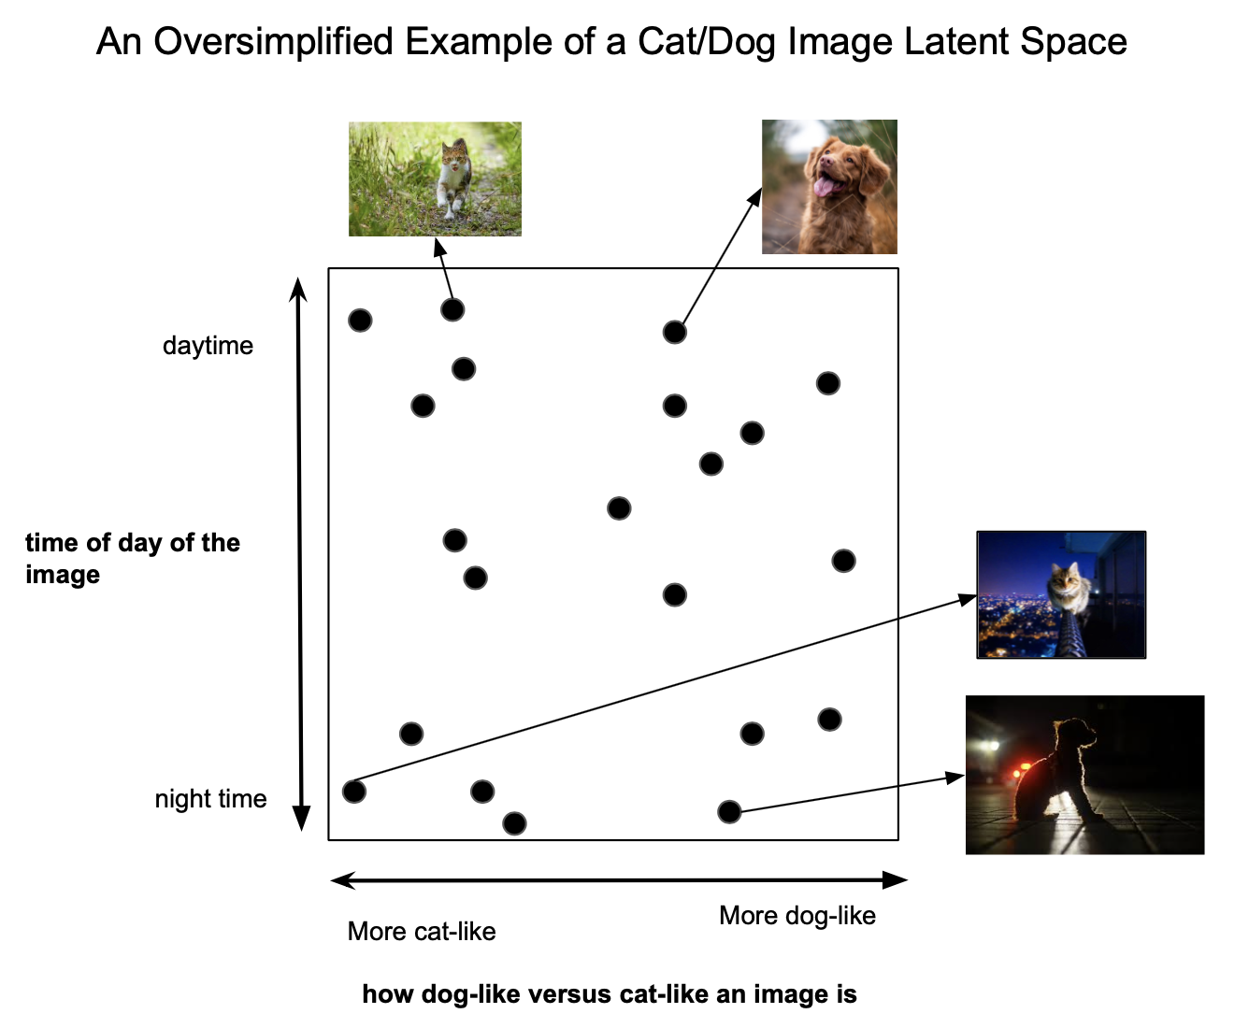
AI Image Generators
1. Gather a dataset
2. Train a model (encoder)
3. Use another model (decoder) &
clever techniques to render the image

Slide 10
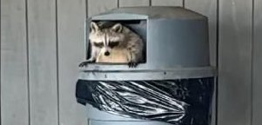
Back to the scene of the crime…

Slide 11
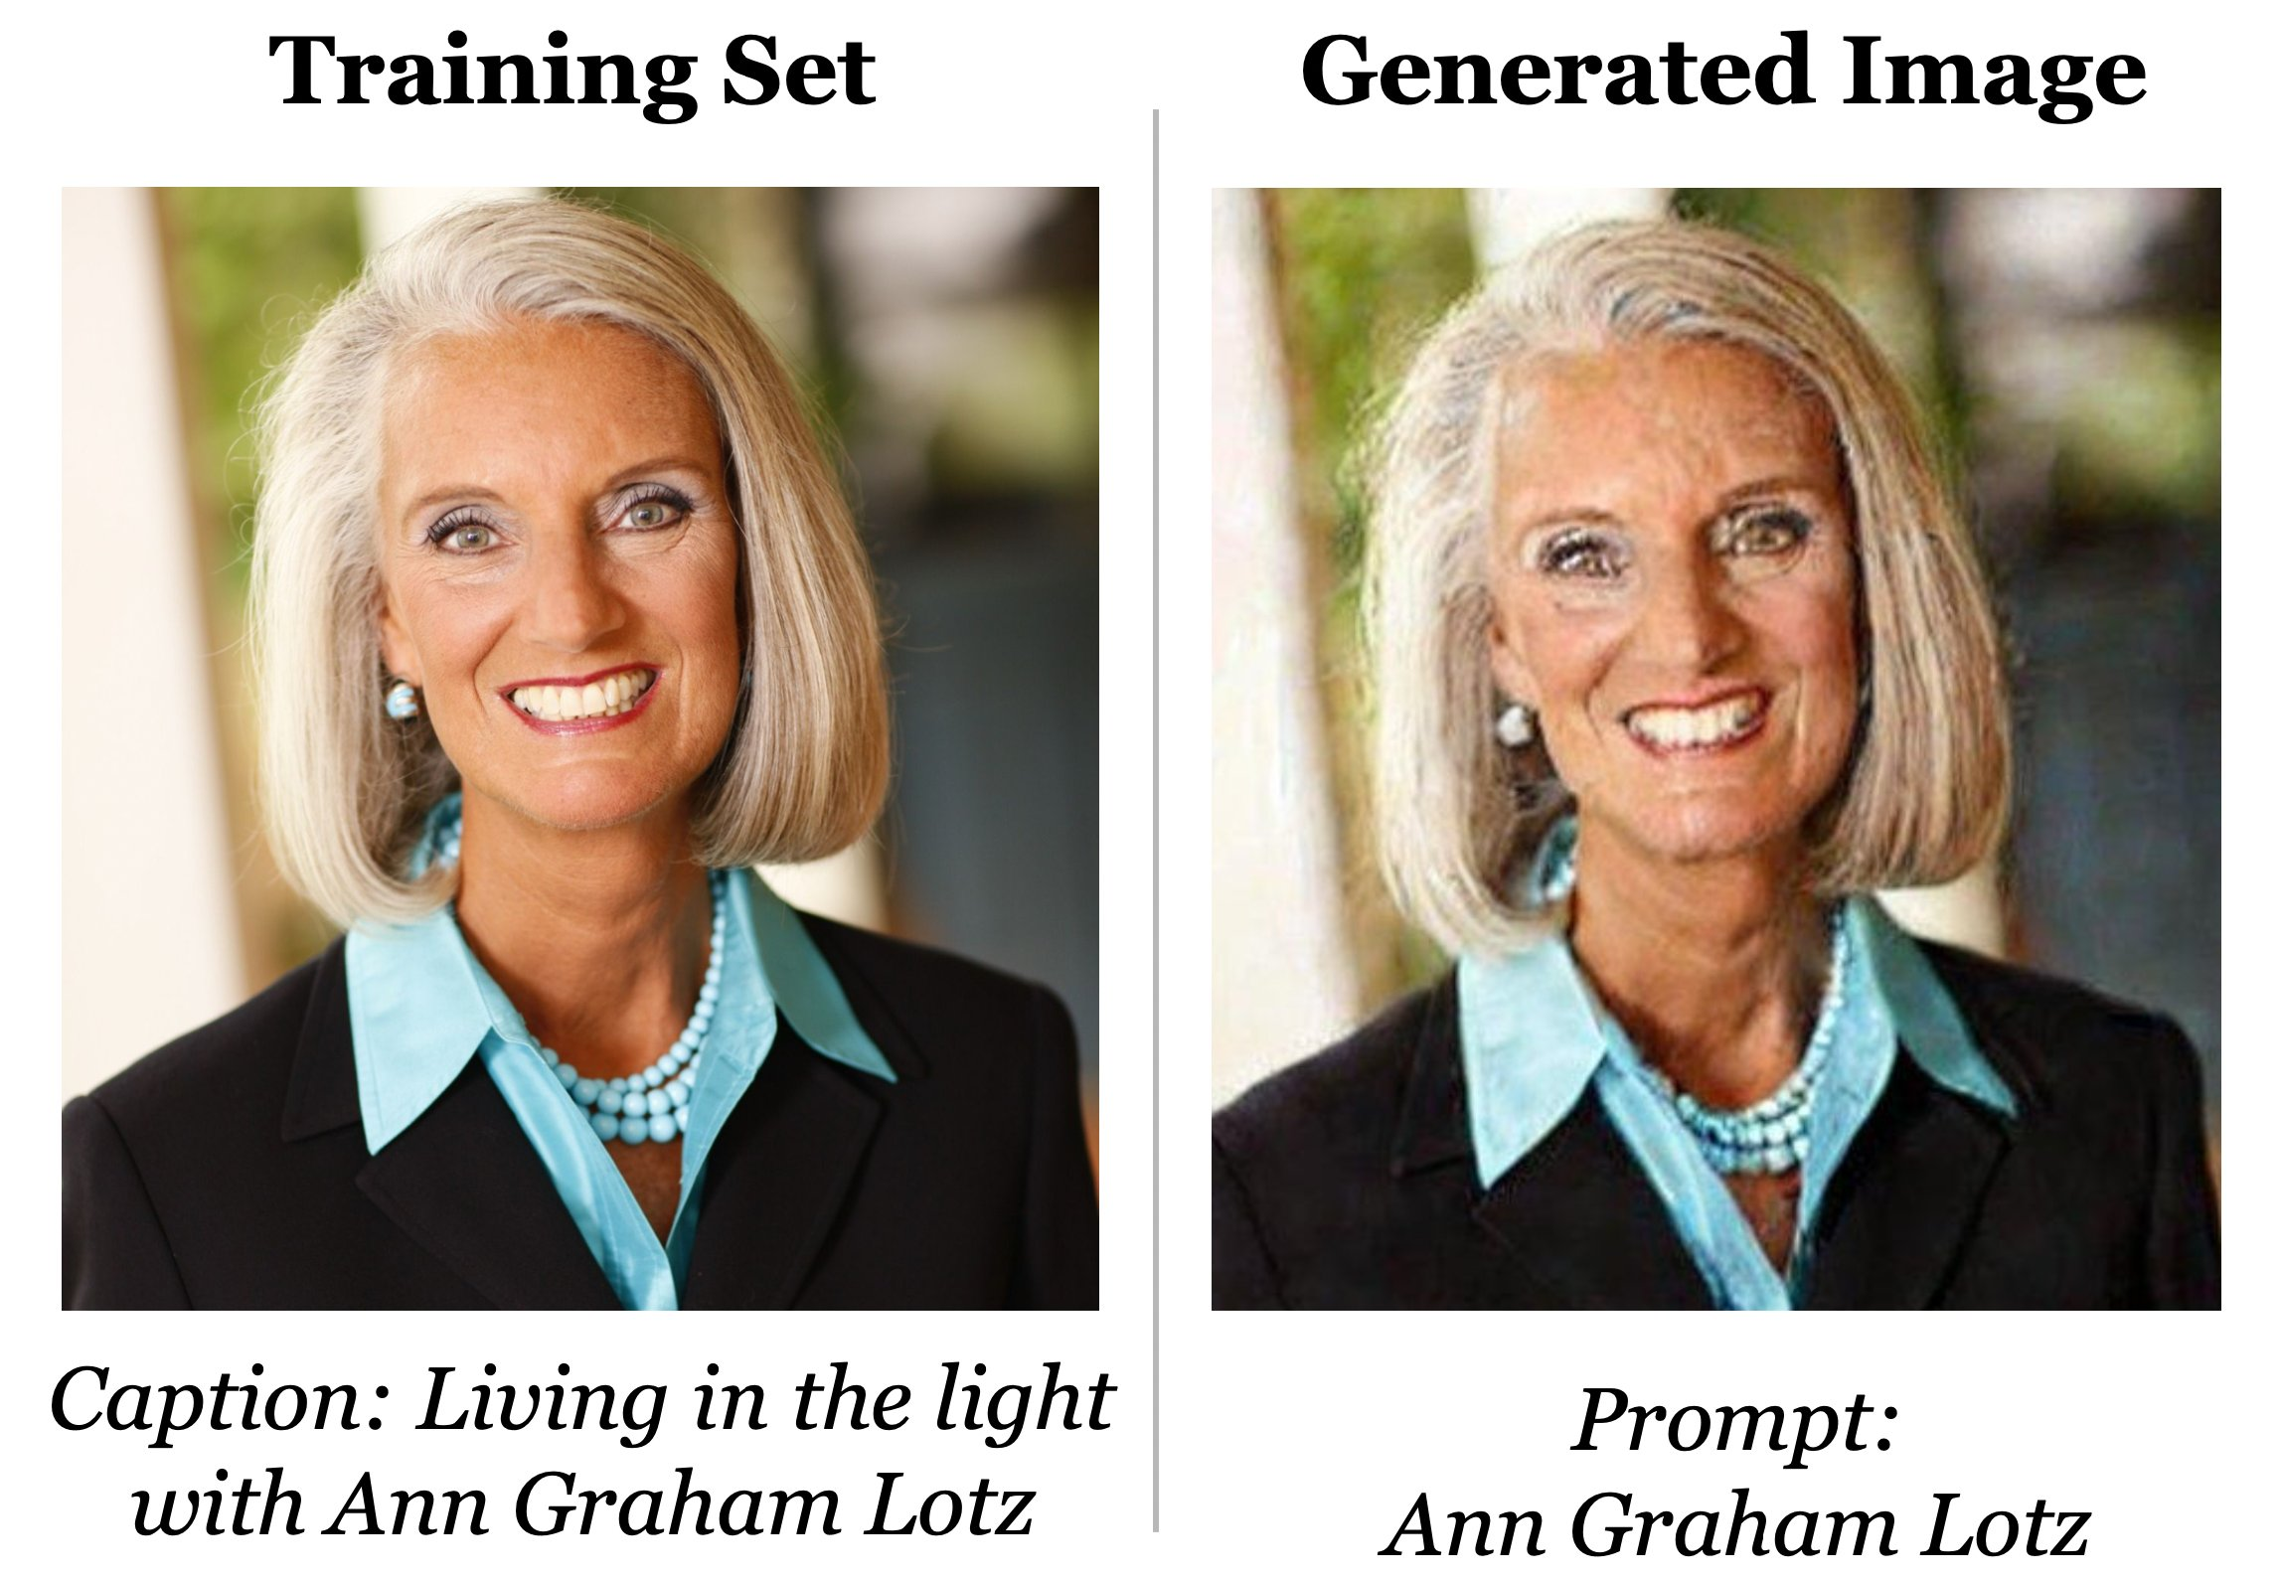
Does AI Steal Art?
❌
Heist
Plagiarism
Style Theft
Labour Theft
✓
❌
✓
✓
❓
✓
🤔

Slide 12
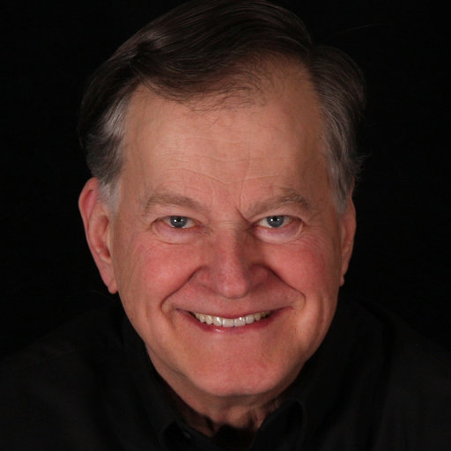
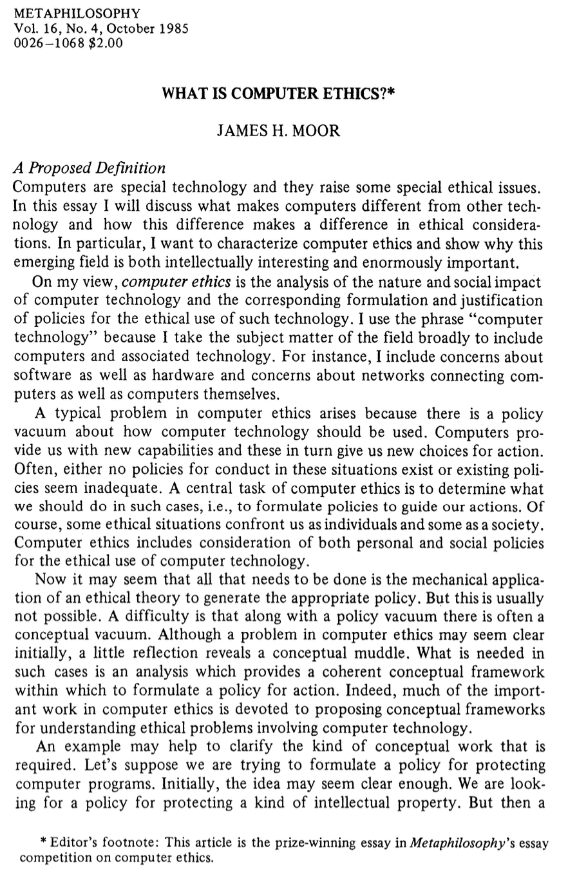
A Feminist Pragmatist Approach to Computer Ethics
James Moor argues new technologies create new possibilities for action.
These new possibilities give rise to gaps in our norms.
Moor argues that we should fill these gaps with philosophical reflection.
I follow the feminist pragmatist approach illustrated by Nancy McHugh:
Centre the lived experiences of those resisting the negative impacts of technology.

Slide 13
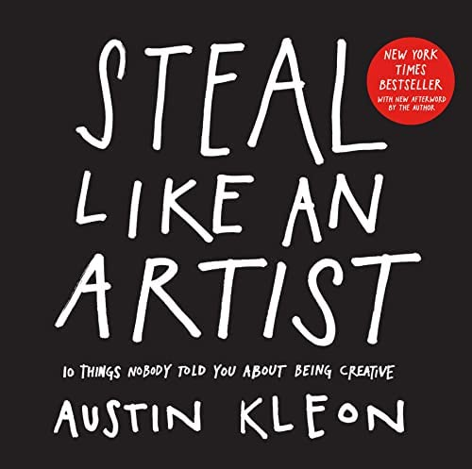
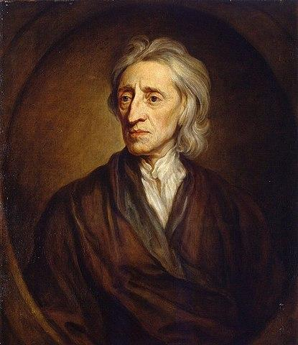
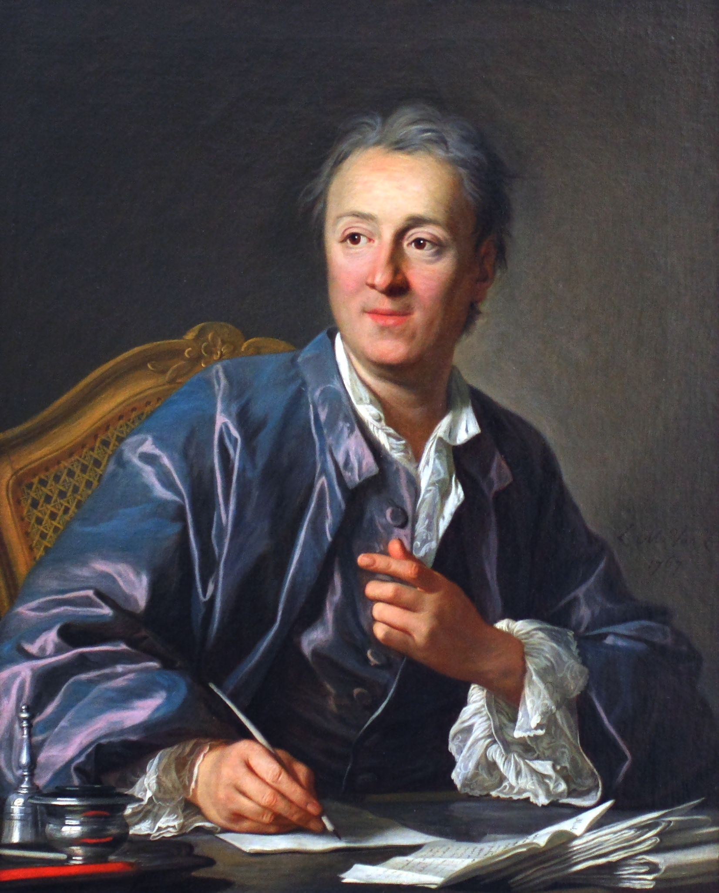
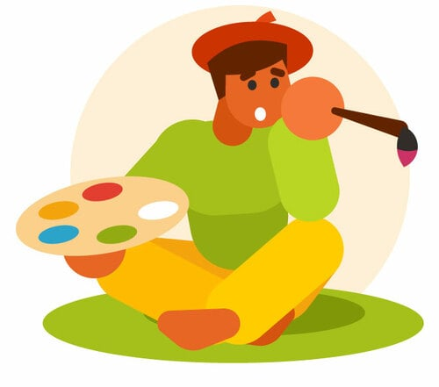
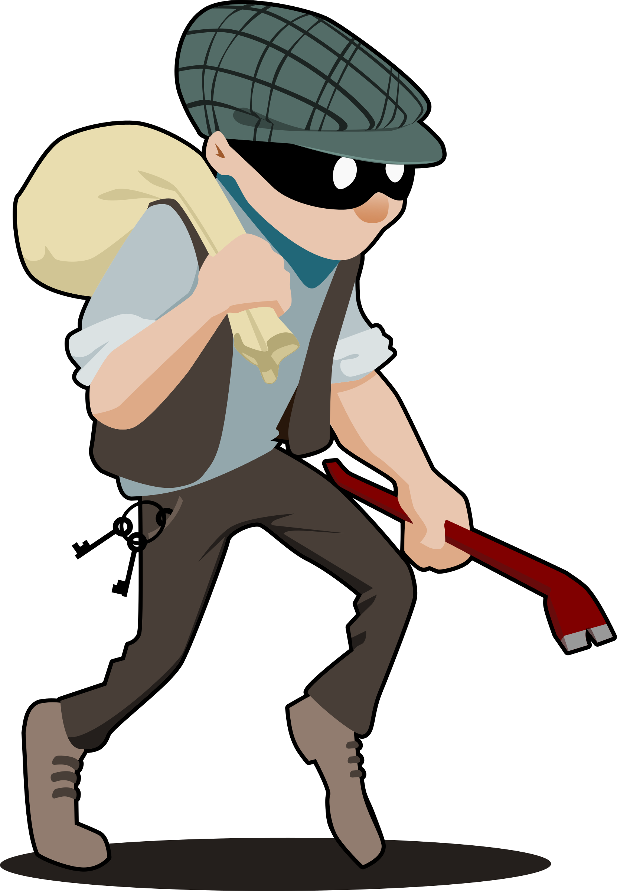
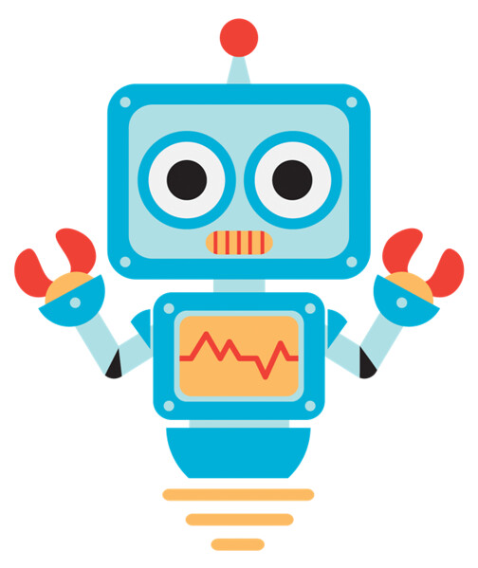
Labour and Creative Property
Some artists argue by analogy to theft of physical labour.
Locke: we are self-owners.
Because we own ourselves, we own our labour.
Because our labour is mixed with the products thereof, we own those products.
Diderot: because the mind is the self, the labour of the mind confers an even more fundamental property right.
Don’t human artists also “steal” from one another?

Slide 14
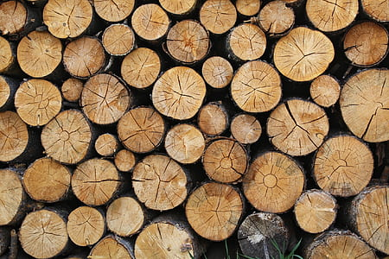
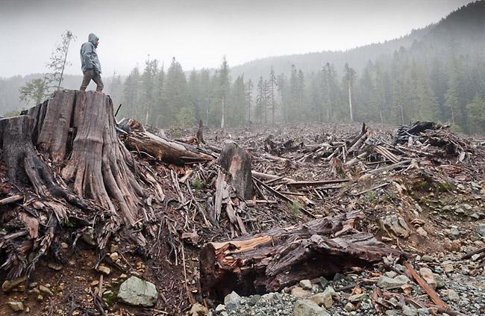
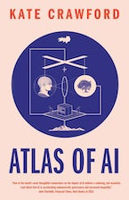
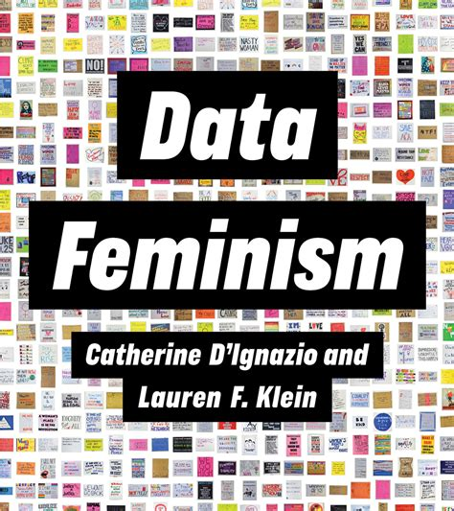
Data Colonialism
Difference in speed and scale is morally significant.
Compare: sustainable timber vs. clear-cutting.
A single human artist works much more slowly and from far fewer references than AI.
Zuboff: tech ventures deploy a “conquest pattern” identical to colonial extraction.
The kind of theft at issue now? Plunder.
Plunder of the artistic community (especially marginalized artists), and of our self expression.

Slide 15
Implications for AI Development
If AI art is theft, then so are:
Natural language generation (GPT)
Code generation (GitHub Copilot)
Music generation (Google Magenta)
Etc.
Other kinds of AI also involve huge datasets of creative work (e.g. natural language understanding).
These may also be theft.

Slide 16
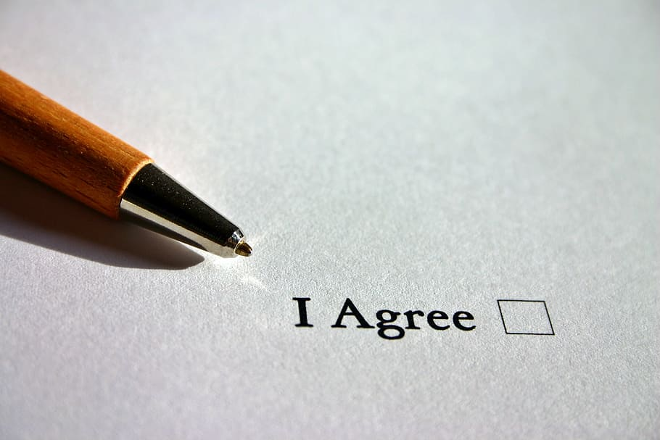
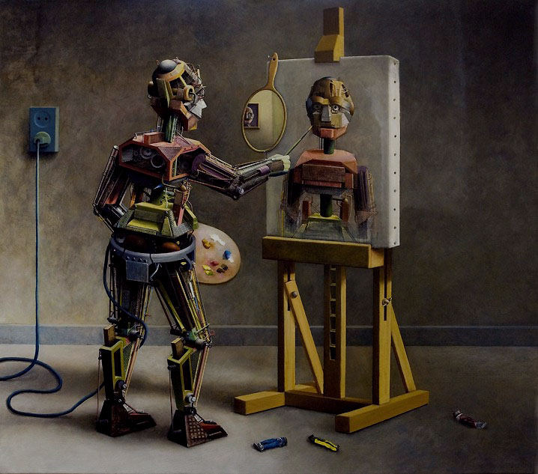
Conclusion
From Locke, Diderot, Zuboff, et al.: generative AI is theft of creative labour.
What to do?
Data subjects opt out as a default
More conscious data curation
Compensation for data subjects
Techniques that don’t require datasets that are quite as massive.
Serious consideration of whether automating creativity is desirable.

Slide 17
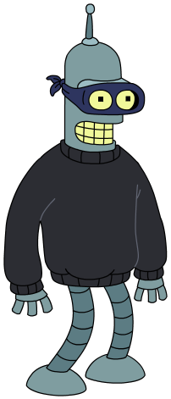
Thanks!
Bibliography
Carlini, N., J. Hayes, M. Nasr, et al. 2023. “Extracting Training Data from Diffusion Models.” arXiv.
Couldry, N., and U. Mejias. 2019. The Costs of Connection: How Data Is Colonizing Human Life and Appropriating It for Capitalism. Stanford University Press.
Crawford, K. 2021. Atlas of AI: Power, Politics, and the Planetary Costs of Artificial Intelligence. Yale University Press.
Diderot, D. 2002. “Letter on the Book Trade.” Trans. A. Goldhammer. Daedalus 131 (2): 48–56.
D’Ignazio, C., and L. F. Klein. 2020. Data Feminism. MIT Press.
Kleon, A. 2012. Steal Like an Artist. Workman Publishing Company.
Knight, W. 2022. “Algorithms Can Now Mimic Any Artist. Some Artists Hate It.” Wired.
Locke, J. 1690. Second Treatise of Government. Ed. C. B. Macpherson. Hackett.
McHugh, N. A. 2015. The Limits of Knowledge: Generating Pragmatist Feminist Cases for Situated Knowing. SUNY Press.
Moor, J. H. 1985. “What Is Computer Ethics?” Metaphilosophy 16 (4): 266–75.
Ramesh, A., et al. 2021. “Zero-Shot Text-to-Image Generation.” arXiv.
Snell, C. 2021. “Understanding VQ-VAE (DALL-E Explained Pt. 1) - ML@B Blog.” Machine Learning at Berkeley.
Weatherbed, J. 2022. “ArtStation Is Hiding Images That Protest against AI Art.” The Verge. December 23, 2022.
Zuboff, S. 2019. The Age of Surveillance Capitalism: The Fight for a Human Future at the New Frontier of Power. Public Affairs.
Contact:
tgoetze@fas.harvard.edu
My website:
https://www.trystangoetze.ca/
Follow me on Mastodon:
@ErrantCanadian@zirk.us
✉️
🌐
🐘

